Slide 1
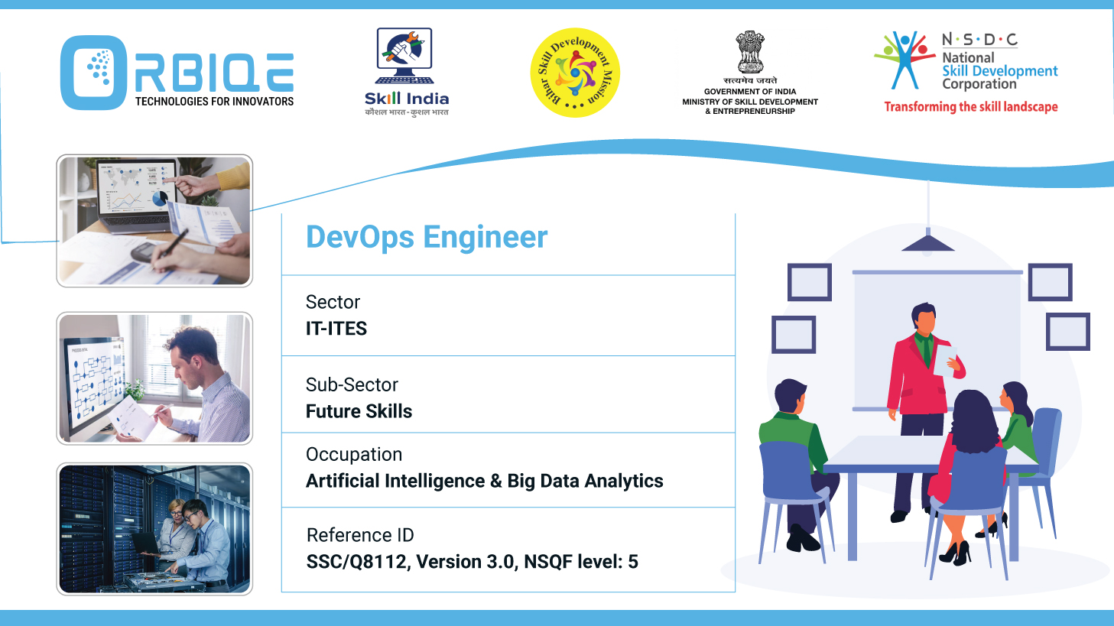
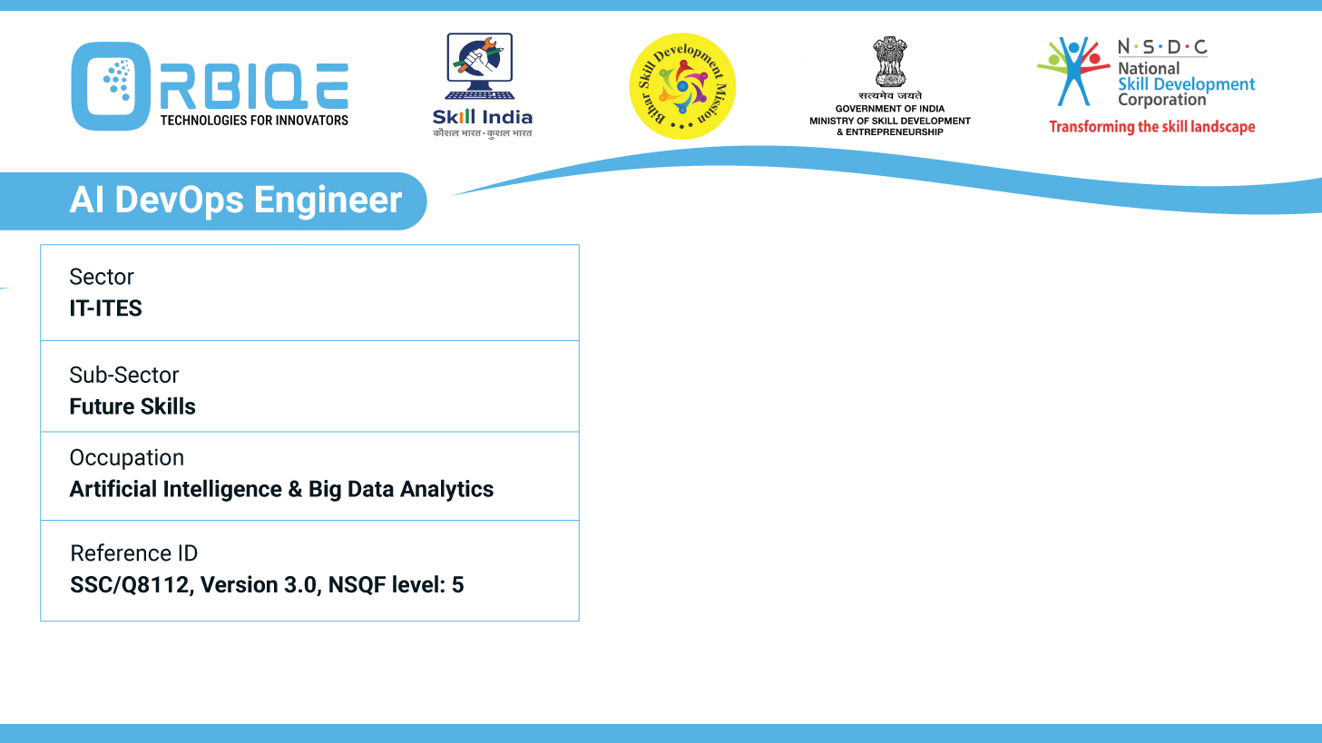
Name- Krishna Kant Dubey

Slide 2

Assessing Completeness and Veracity: Troubleshooting Database Issues

Slide 3
Agenda
Demonstrate the methods to assess and troubleshoot issues related to database completeness and veracity, ensuring data accuracy and reliability.

Slide 4
Assessing Data Completeness
Techniques:
Schema Validation: Ensure all mandatory fields are filled.
Null Checks: Identify missing values in critical columns.
Record Count Comparison: Compare source vs. destination counts post-migration.
Referential Integrity Checks: Validate foreign key relationships

Slide 5
Evaluating Data Veracity
Methods:
Source Validation: Cross-check data against authoritative sources.
Outlier Detection: Use statistical methods to flag anomalies.
Metadata Analysis: Review timestamps, origin, and transformation history.
Manual Sampling: Spot-check records for logical consistency.

Slide 6
Troubleshooting Data Quality Issues
Data Profiling: Analyze distributions, patterns, and anomalies.
Validation Rules: Apply business logic to flag incorrect entries.
Logging & Auditing: Track data changes and identify corruption sources.
Peer Review & Dashboards: Compare outputs with trusted analytics.

Slide 7
Implementing Data Quality Management
Define Quality Metrics: Accuracy, completeness, consistency, timeliness.
Automate Validation Pipelines: Use CI/CD tools for real-time checks.
Cross-functional Collaboration: Involve stakeholders across departments

Slide 8
Thank You

